Slide 1
House-Hold Rental Team-Alpha Final Project Presentation: End to End + Deployment CPSC 5240-01 Software as a Service By, Amogha Lavanya Sravya
An e-commerce website which provides a platform for renting household goods, electronics, fashion items, furniture, art-painting, cars, bikes etc.

Slide 2
Links to website
Source code
https://github.com/amoghaprakash/SAASCodeRep
Deployed website (Azure Cloud) https://householdrental.azurewebsites.net/houserentalapp/login.jsp
YouTube video
https://www.youtube.com/watch?v=Zw8JTST-nb0&feature=youtu.be
Trello
https://trello.com/b/1wRId8j6/house-hold-rental

Slide 3
User Stories - Amogha
Complete Framework Design Complete Final Integration, Add cookies, navigation etc Complete Azure Deployment
Login page SignUp page ResetPassword page Listing - Home page Header functionality Image Upload and Retrieval
(CRU operations for all pages)

Slide 4
User Stories - Lavanya
Item creation Page
- Inserting item details
Item Display Page -Fetching item details -Fetching owner details -Date functionality -Google Maps
Add to Cart Functionality
-An Item can be added only once
Design Relevant UI pages

Slide 5
User Stories - Sravya
Database design for the application
Cart page functionality - Retrieving cart details, - Deleting item in cart, - Deleting items from cart table and insert in order table Order Confirmation page
Design Relevant UI for the pages

Slide 6
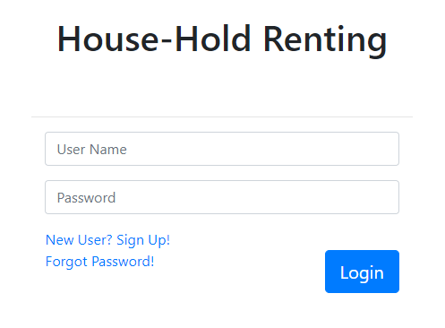
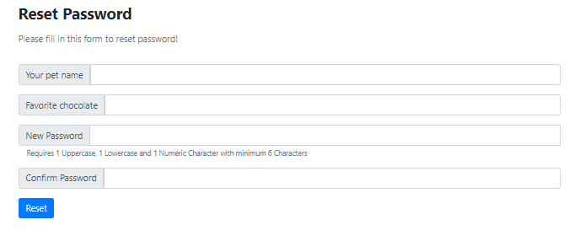
As a user I want to login to the website using my credentials so that I can personalize my usage.
As a user I want to reset my password so that I don’t lose access to it forever.

Slide 7
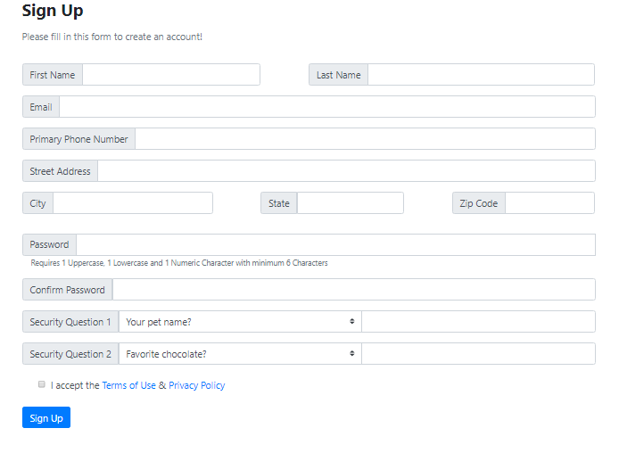
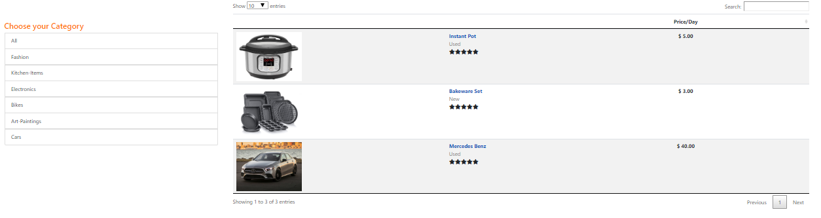
As a new user I want to signup so that I can create my own account.
As a new user I want to see all the items available on the website so that I can choose what I like.
As a user I want to see different categories of items so that I can filter my search.
As a user I want to search for a product so that I don’t have to scroll through every page.

Slide 8
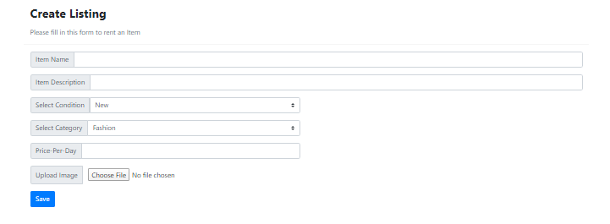
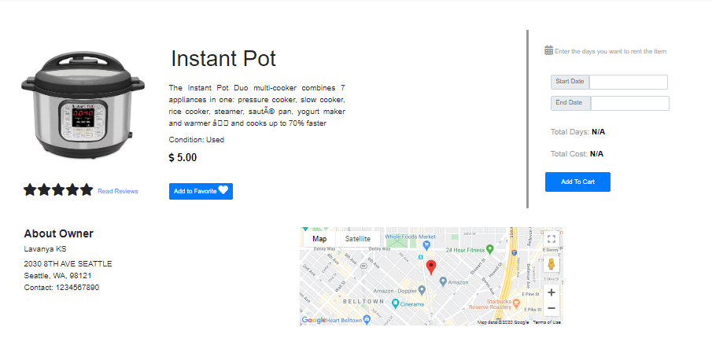
As a owner I want to enter my Item details so that it is available for others to rent.
As a user I want to see the details of each Item so that I can decide if I want to rent it.
As a user I want to add an item to the cart so that I can rent it.
As a user I want to see the owner location on maps so that I can know if it is convenient for me to rent it.

Slide 9
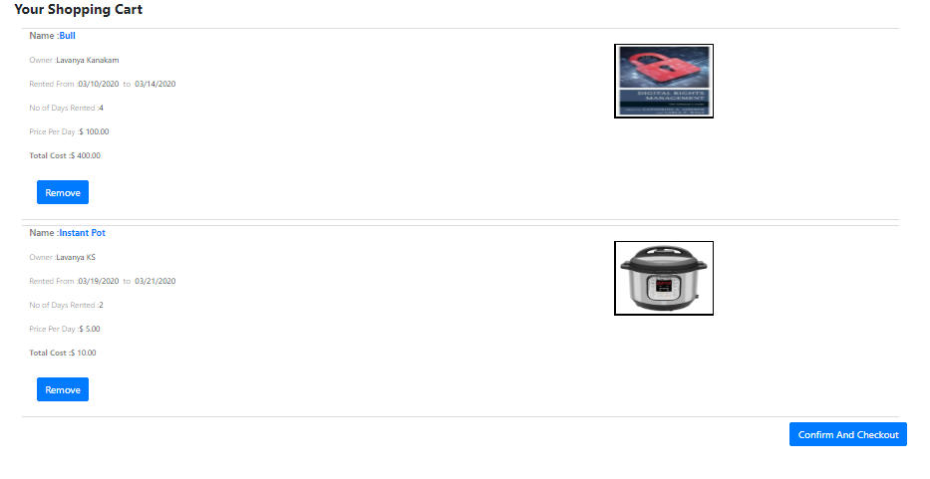
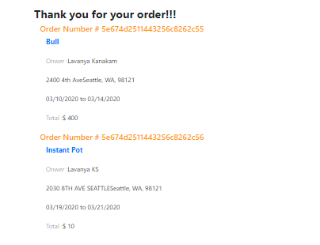
As a user I want to see the list of all items in the cart so that I know what I am going to rent.
As a user I want to remove an Item from the cart so that I can check out only those Items I need.
As a user I want to confirm and checkout my order so that I am sure of getting it.
As a user I want to see the order I have placed along with the owner details so that I can be assured that the order was placed.

Slide 10
As user I want to logout of the website so that I can safely end my session

Slide 11
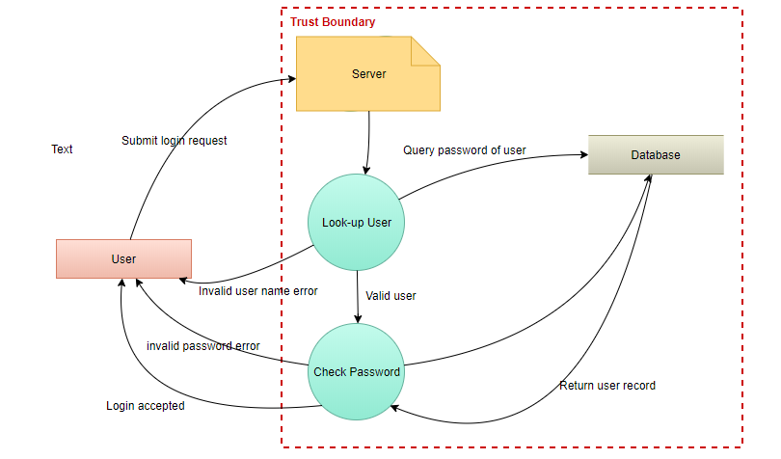
Security Threat Model
As a user I want to login to my website using my credentials so I can personalize my experience.

Slide 12
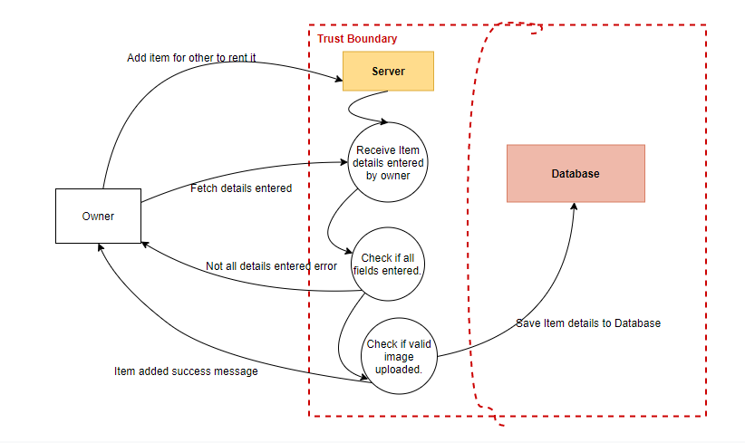
As a owner I want to create an item so that it is available for other to rent.

Slide 13
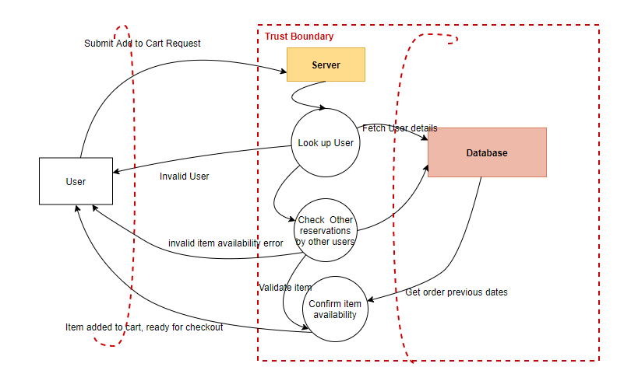
As a user I want to add an item to cart so that I can confirm and checkout.

Slide 14
Amogha - Extra Credit : Additional user stories
Note :
Condition for review button to be enabled:
Since User can add review only if the return date is greater than today’s date
User can add review for the same item only once.
For testing Azure link
https://householdrental.azurewebsites.net/houserentalapp/login.jsp
Extra Set of login credentials – User Name : test@t.com Password: Test1234
Item Name - Cruiser Bike Review button enabled for testing( return date is 02/18/2020)

Slide 15
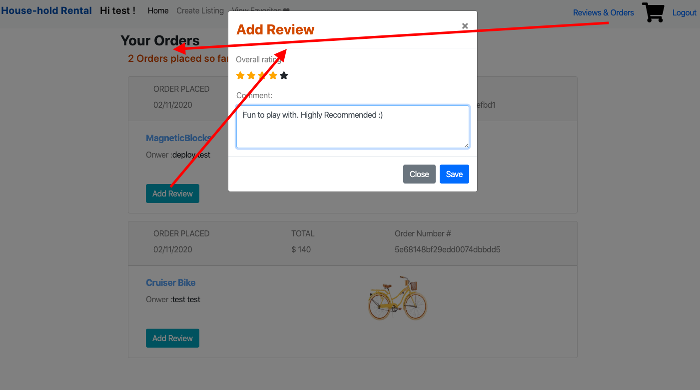
User Story – Order History and Add review
As a user I should be able to check my all past order history
As a user I can only click on Add Review after my return item date. Otherwise button will be disable.
As a user I can add review one time/ item/order. Otherwise button will be disable
As a user I should be able to add star rating for the item I purchased.
As a user I should be able to add comments.

Slide 16
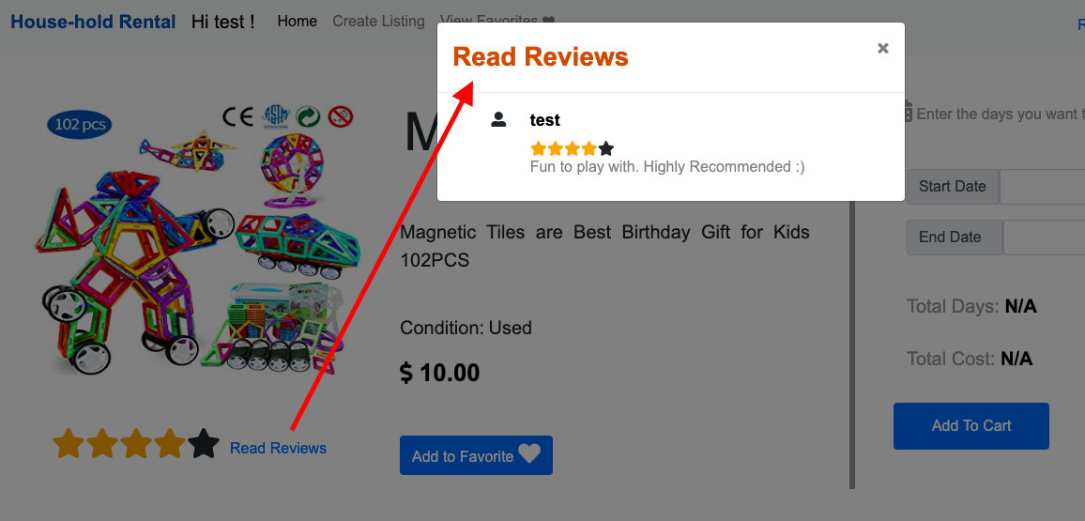
User Story – Read Reviews
As a user I should be able to see average star rating in home/listing page and Individual rating in popup.
As a user I should be able to see reviews in item description page(popup) on click of Read Reviews.

Slide 17
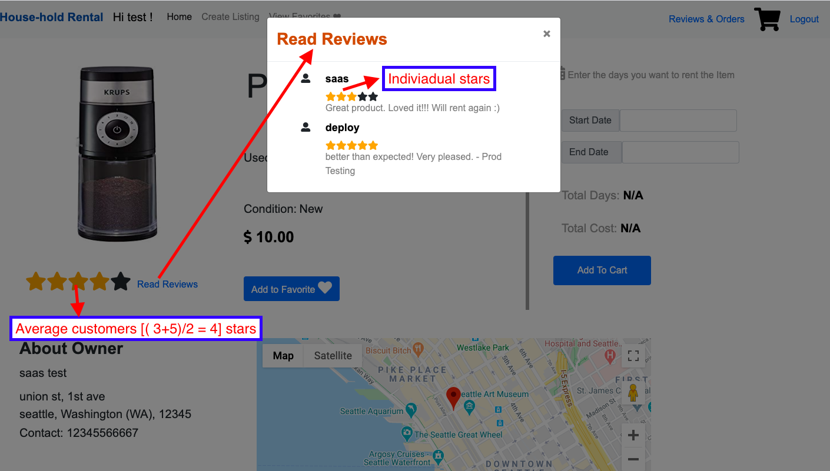
User Story – Average Star Rating

Slide 18
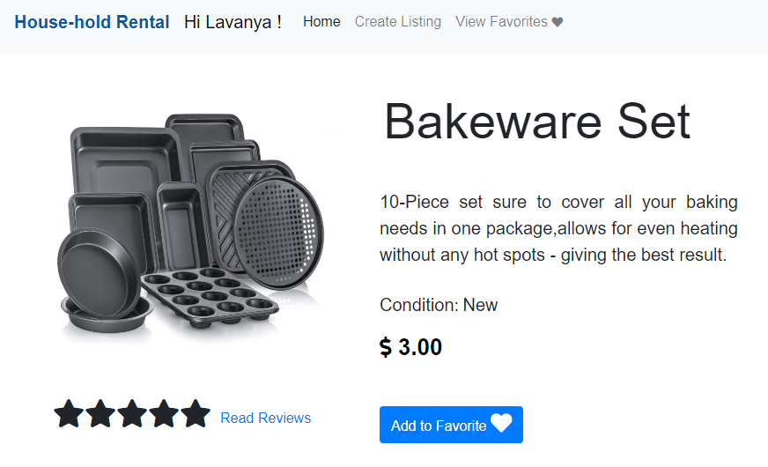
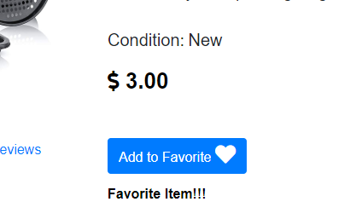
Lavanya: Extra Credit
As a user I want to add an item into my favorites list so that I can easily view them the next time I want.

Slide 19
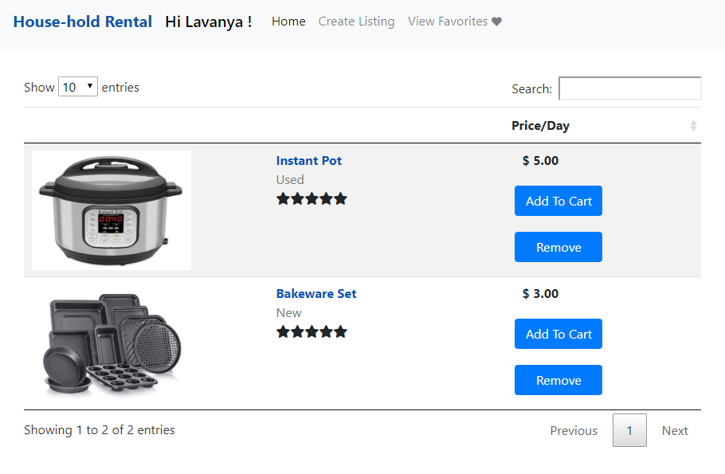
On Clicking View Favorites

Slide 20
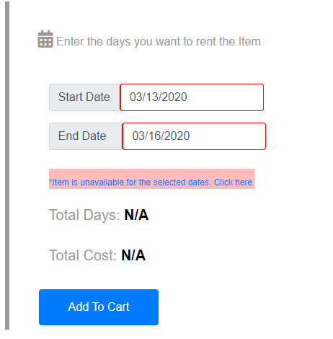
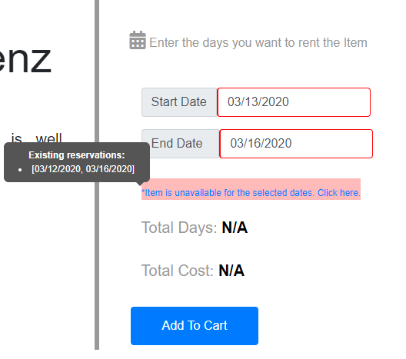
User Story 2
As a user I do not want to have a conflict with other users when renting an item because two users may want to rent an item at the same time.

Slide 21
Thank you!!

